Slide 1









Item-Based Collaborative Filtering
Hotel1
User1
Hotel2
Similar Hotels
Hotel3
User2
Hotel4
User1
User3
User2
Visited Hotels
User3
Recommended Hotels
Hotel5

Slide 2
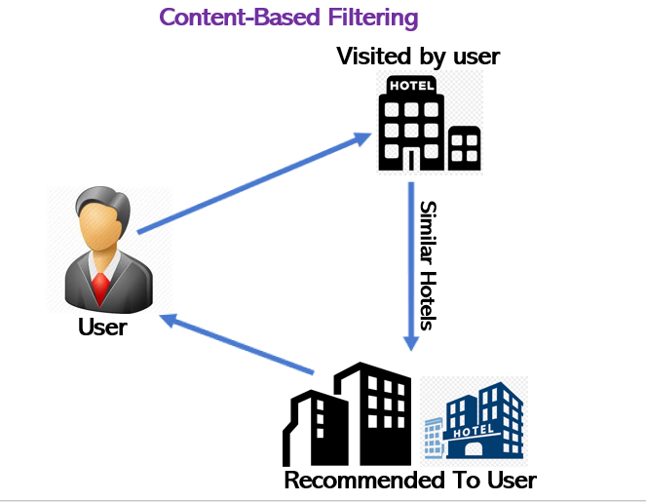

Slide 3
